Slide 1
WE’VE BEEN TAUGHT TO RECYCLE.
NOW IT’S TIME TO LEARN TO RECYCLE CORRECTLY.

Slide 2
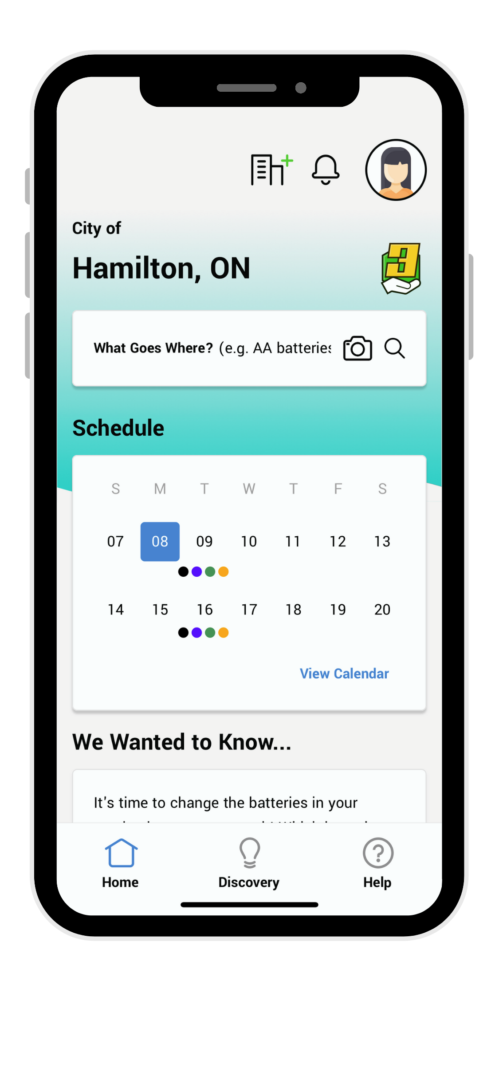
Stage 3: Essentials Package
What Goes Where - full version with IMAGE SEARCH
Complete pick-up and event schedules/reminders
Report-a-Problem
Notifications
Marketing assistance
Full analytics
Dedicated Web App
*Paid for by NJ DEP

Slide 3
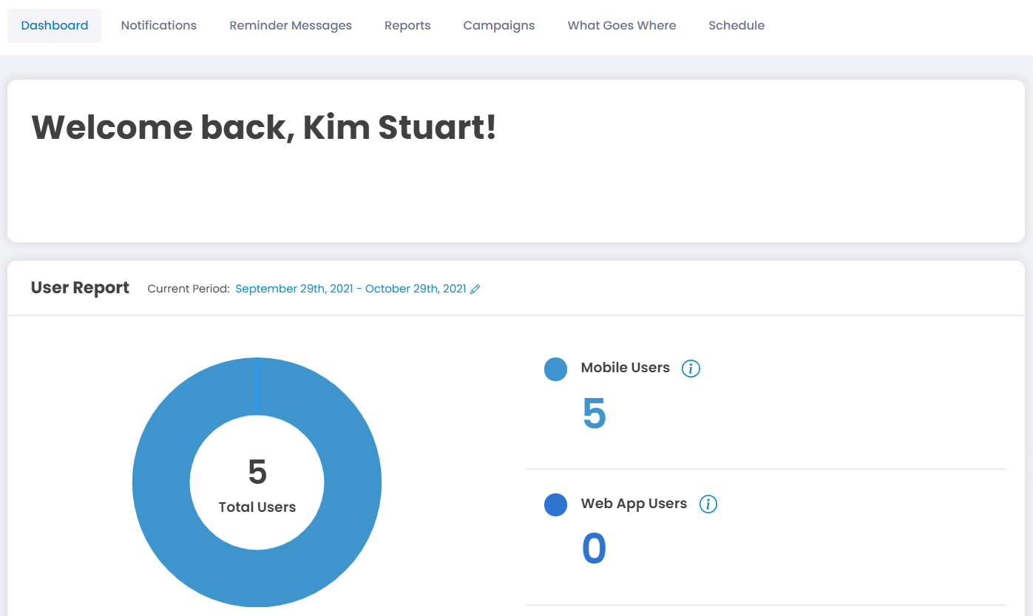
Admin Portal
Keep your disposal information up to date by updating your WGW tool
Preview your calendar schedule 6 months at a time
Send notifications to users to keep them up to date with what is happening in the community
View reports to see how many users you have gained, and how they are interacting with the app
Send reminders to users about their scheduled pickups or changes to their pickups

Slide 4
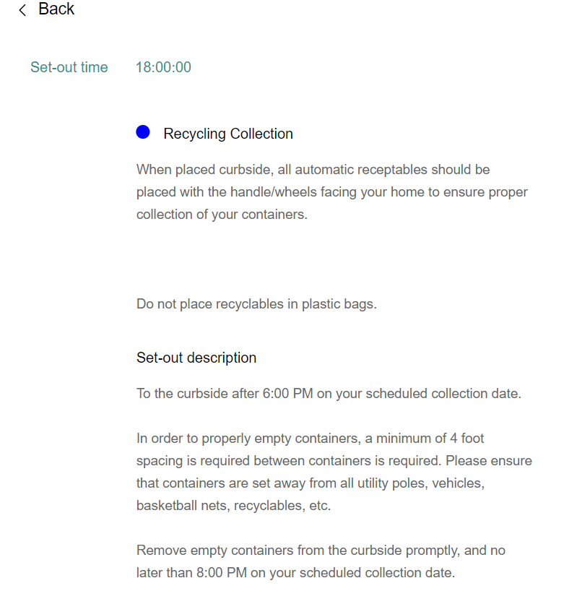
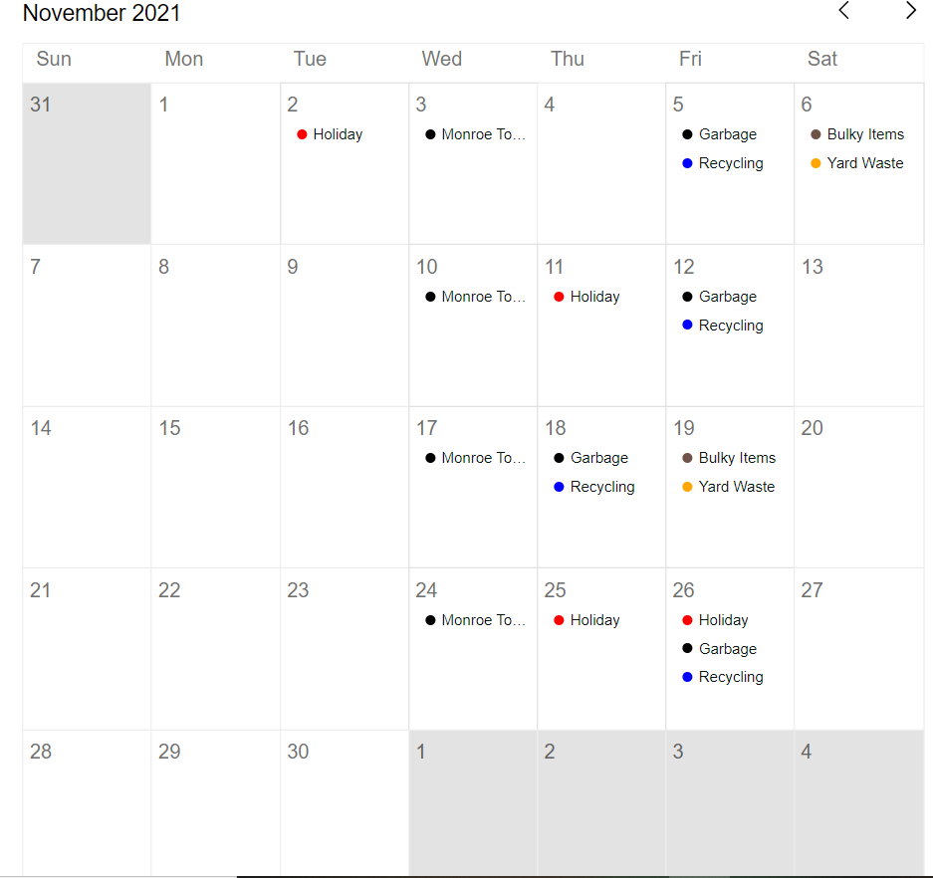
Calendar Example

Slide 5
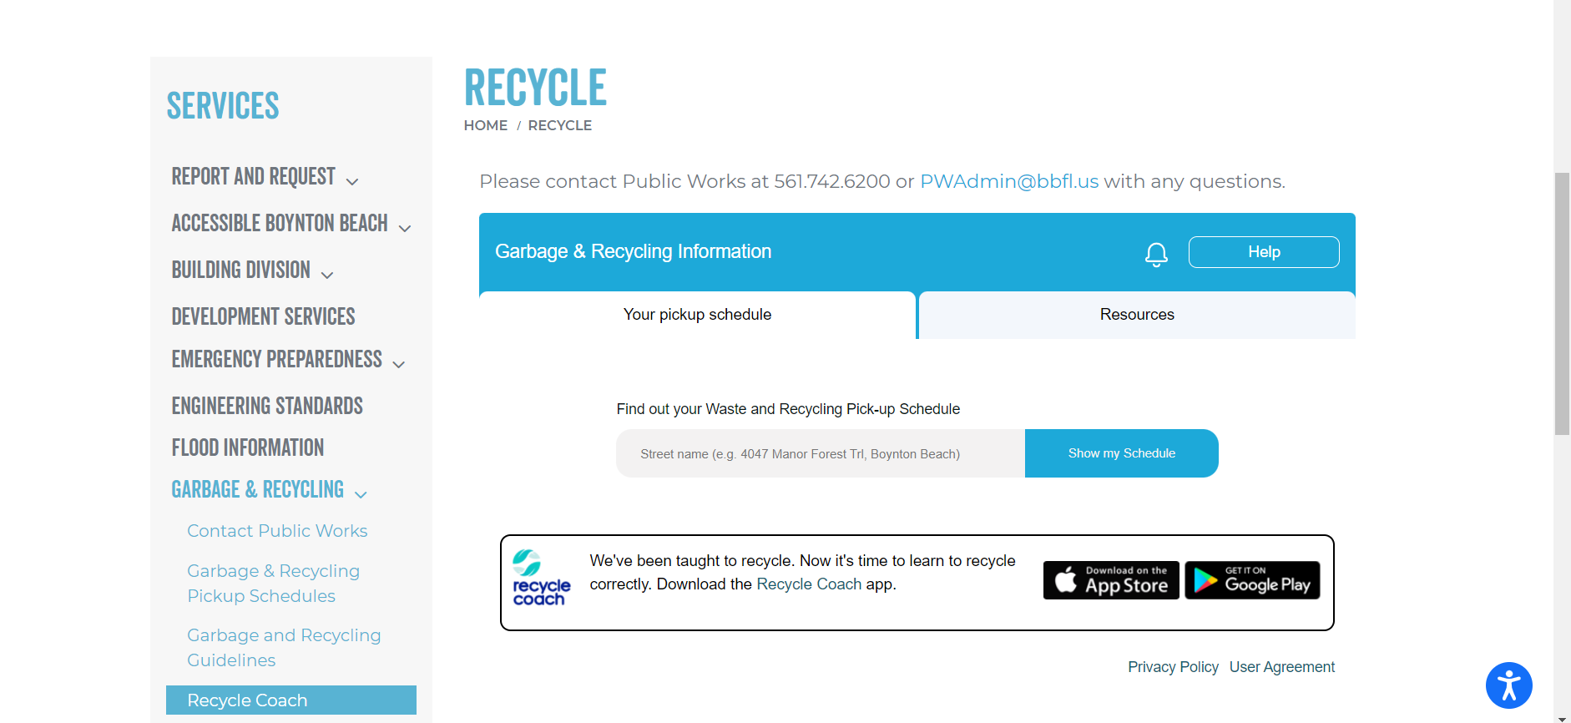
Web App Update
Optimizing web app placement can increase users by up to 5X

Slide 6
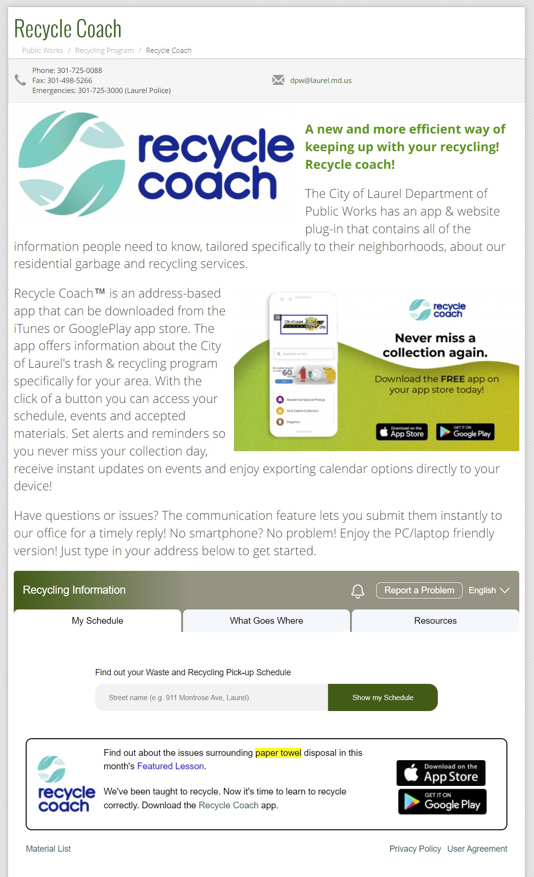
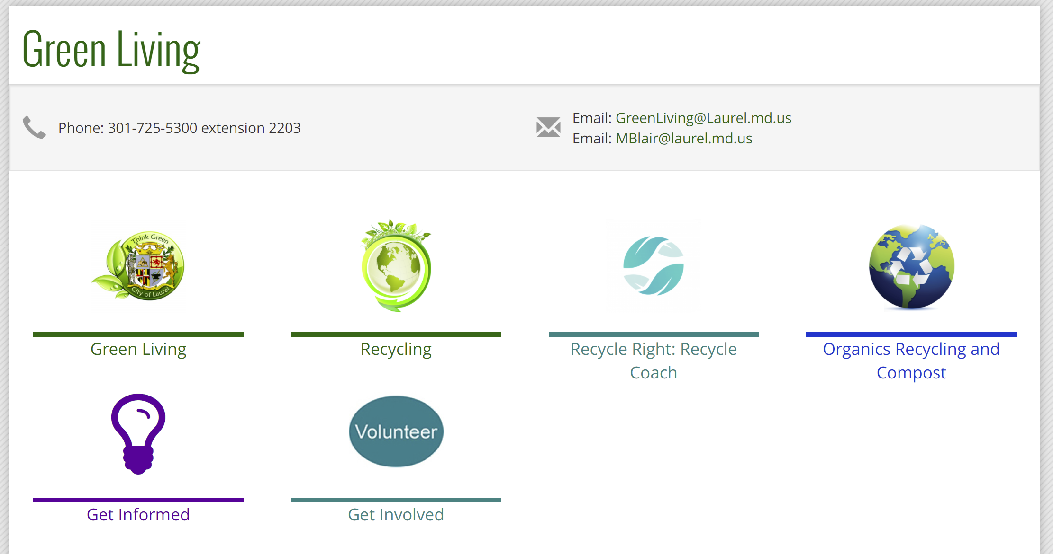
Best Practices
Take it from our clients in Laurel, MD

Slide 7
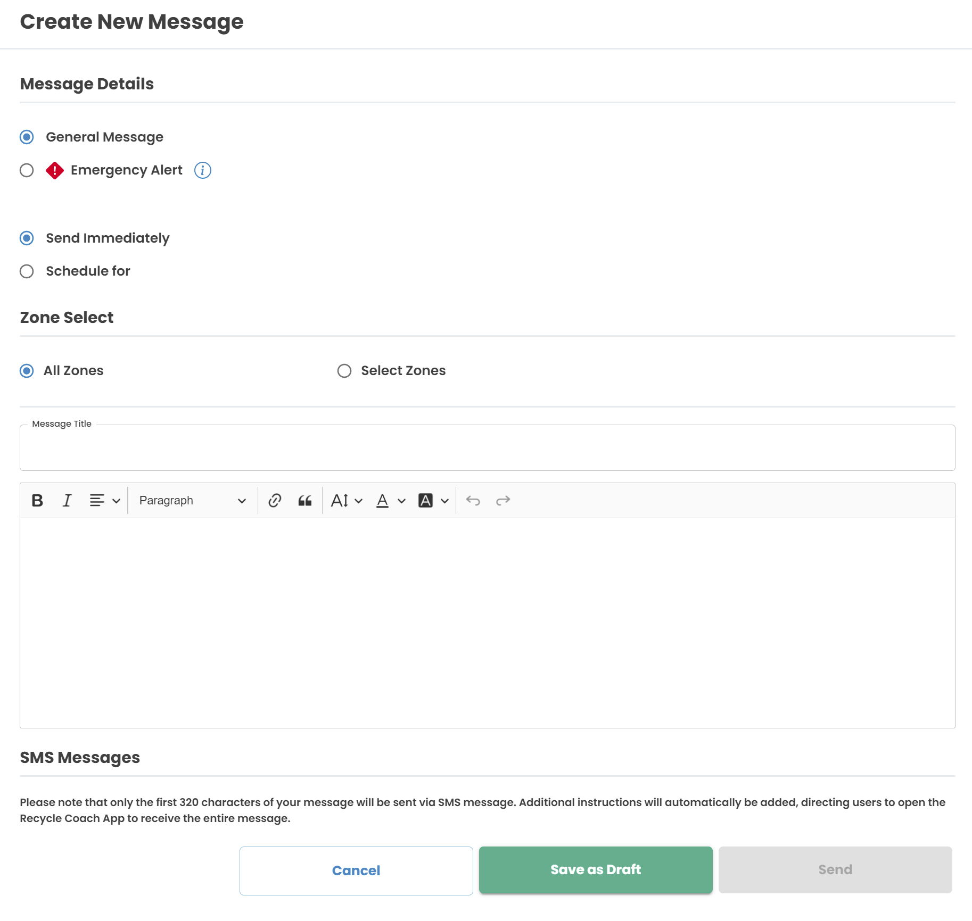
Notifications
Send out push notifications to residents through our Client Admin Portal.
Specify if it is General Information or Emergency Alerts
Notifications can be scheduled or immediate
Select all residents or narrow in on a specific zone
Customize your messaging & add links to webpages where needed
Notifications can provide important waste & recycling information and can be used to promote better recycling habits among residents.

Slide 8
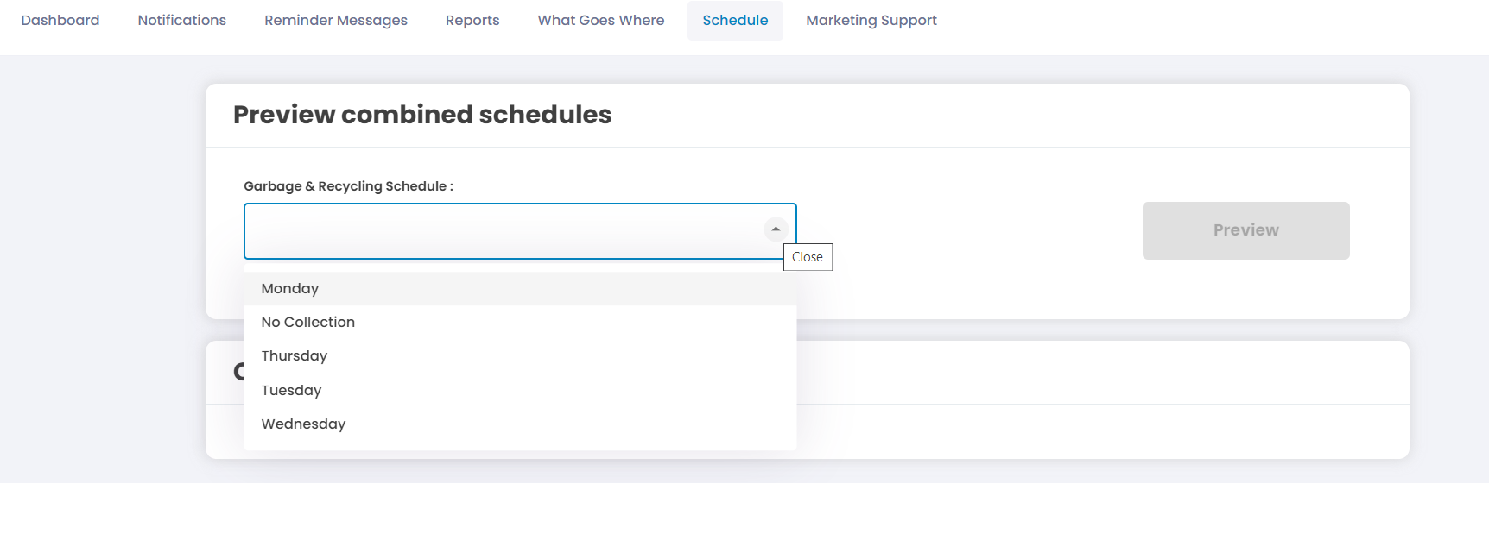
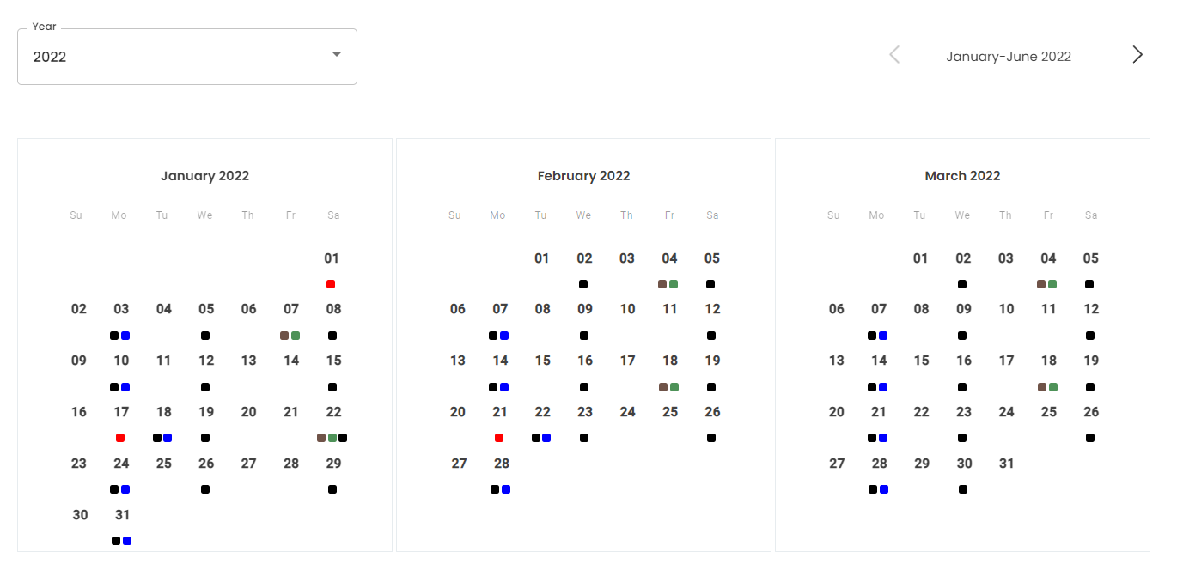
Check Your Schedule
Select which schedule you would like to preview.
Ability to check all scheduled pickups and events in that area

Slide 9
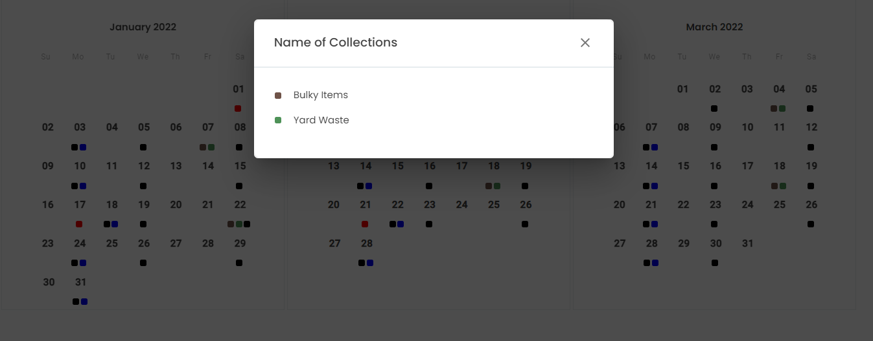
What Do The Colors Mean?
You can click on any of the dates to see what collections are scheduled
Key at the bottom of the page

Slide 10
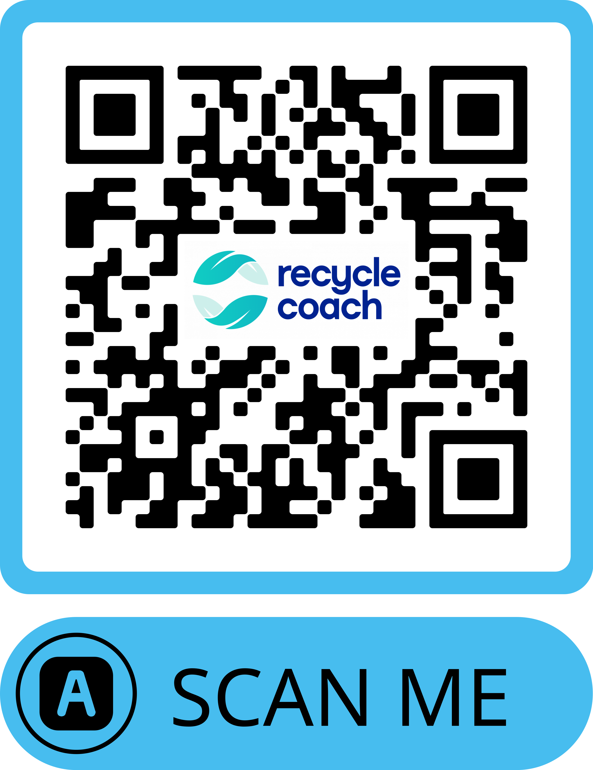
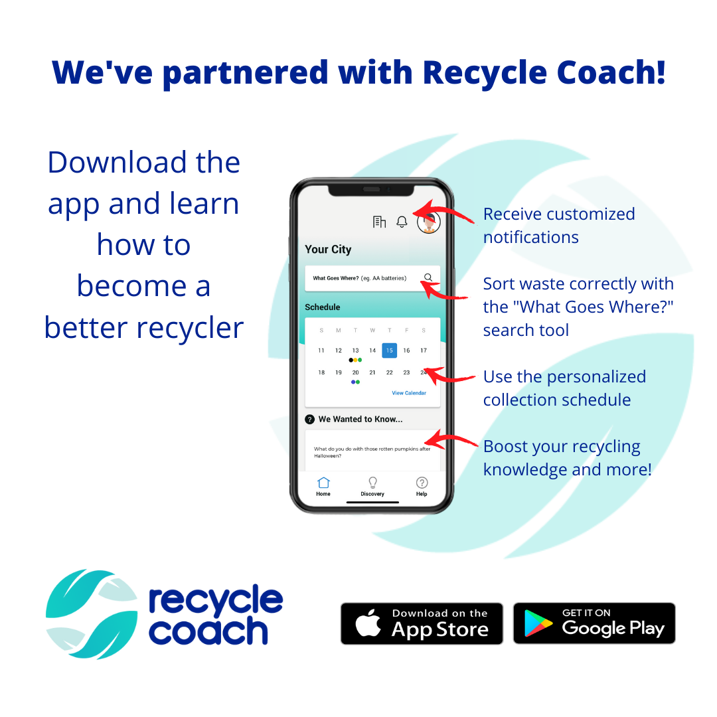
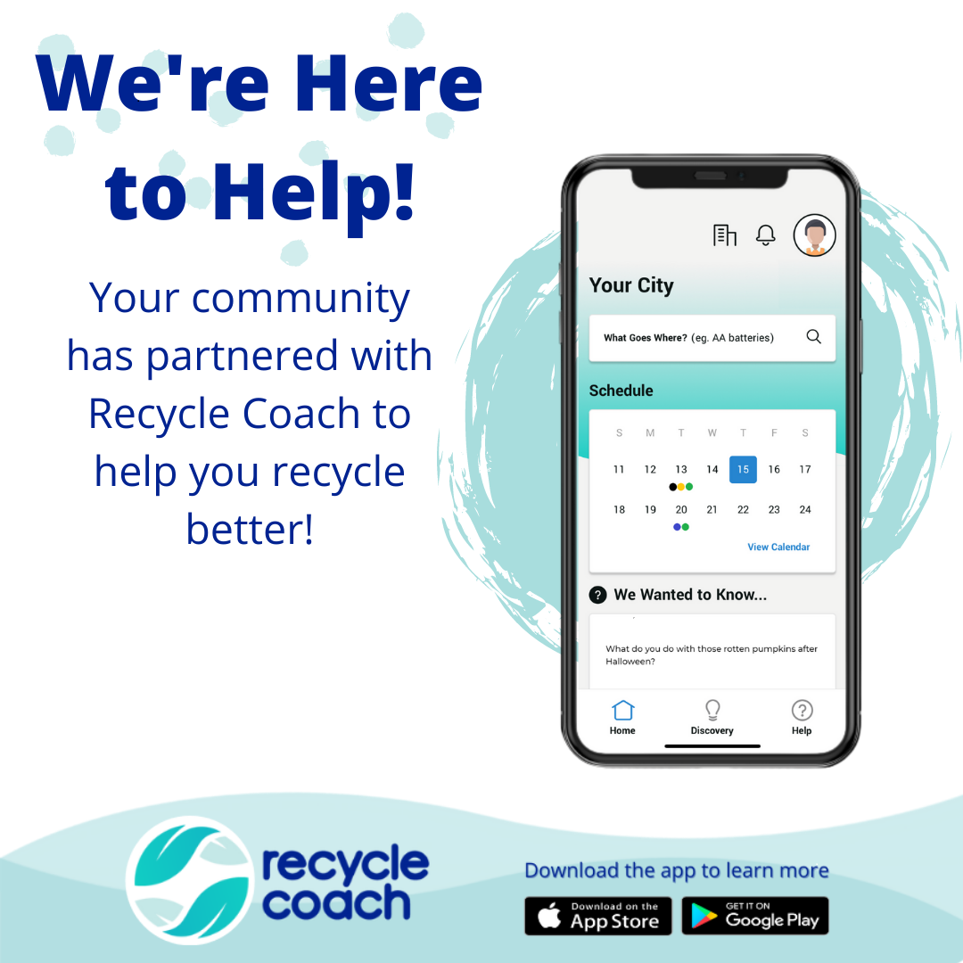
Marketing Support

Slide 11
Kim Stuart
Customer Success Manager
T: 732-991-6489
E: kstuart@recyclecoach.com

